Slide 1

Sprocket Central Pty Ltd
Data analytics approach
ADEJAYAN EBUNOLUWA

Slide 2
Agenda
Introduction
Data Exploration
Model Development
Interpretation

Slide 3
Introduction
Project's objective is to identify and suggest the Top 1000 Customers
Outline of the issue
Sprocket Central Pty Ltd is a medium size bikes & cycling accessories company.
The company has a sizable dataset about its clients, but the team needs help on how to use it to optimize its marketing plan.
Which, on the other hand, support or encourage sales and boost revenue.
Noting that this analysis will be carried out with the 3 phases of Data Exploration, Model Development and Interpretation.

Slide 4
Data Exploration
Data Quality Assessment
The following was used to check for data quality:
Accuracy: Check for correct values
Completeness: Data fields with no value
Consistency: Values not contradicting
Currency: Values are up to date
Relevancy: Value Meta Data
Validity: Data containing allowable value
Uniqueness: Records that are duplicate

Slide 5
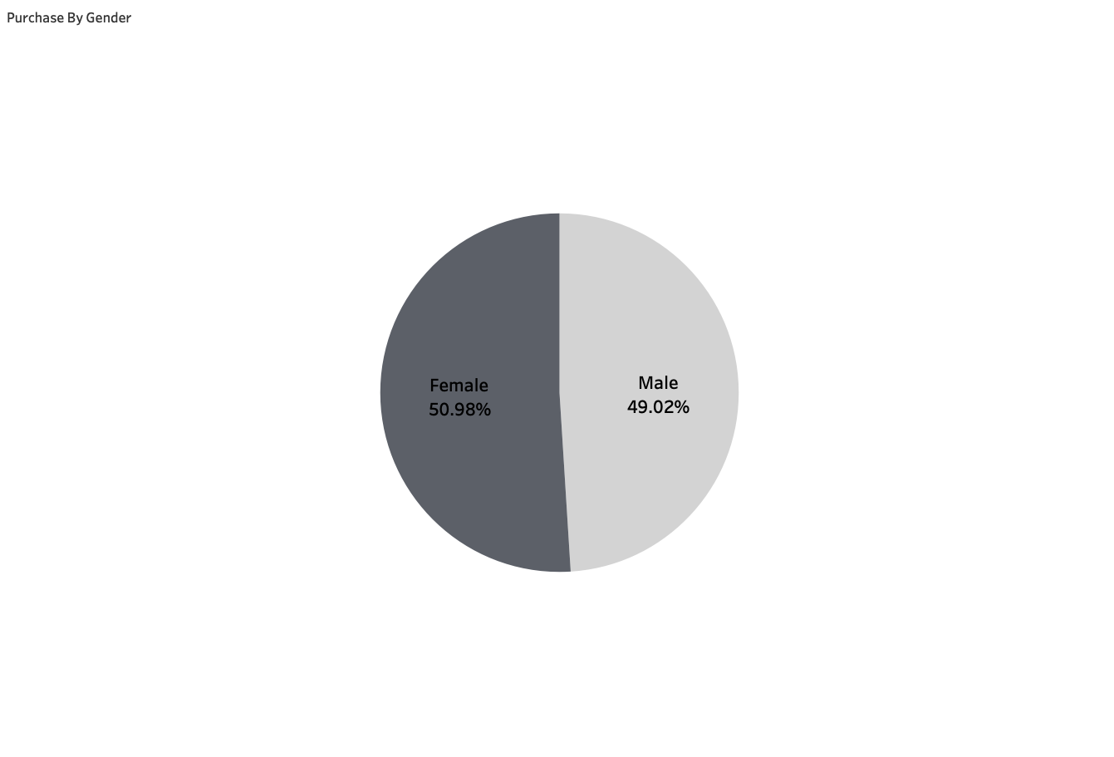
Data Exploration
Recent Bike Purchase Based On Gender And Job Industry
In the past one year,
According to data, women have spent more money on bicycle-related items than men.
On average, women have purchased 2% more bikes than men have.
Manufacturing, Financial services, and Health are the top three industries in terms of profit.
Most of these sectors generated profits of at least $1,000,000.

Slide 6
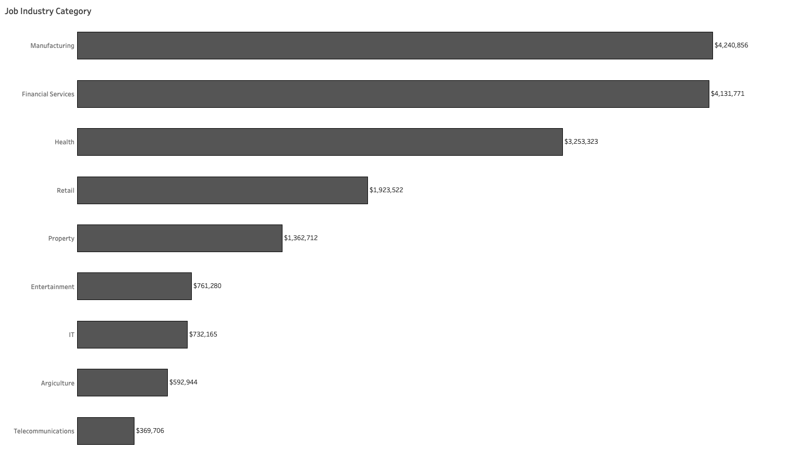
The majority of the top 3 industry sectors are located in cities, so it may be clear that consumers choose biking for commuting.

Slide 7
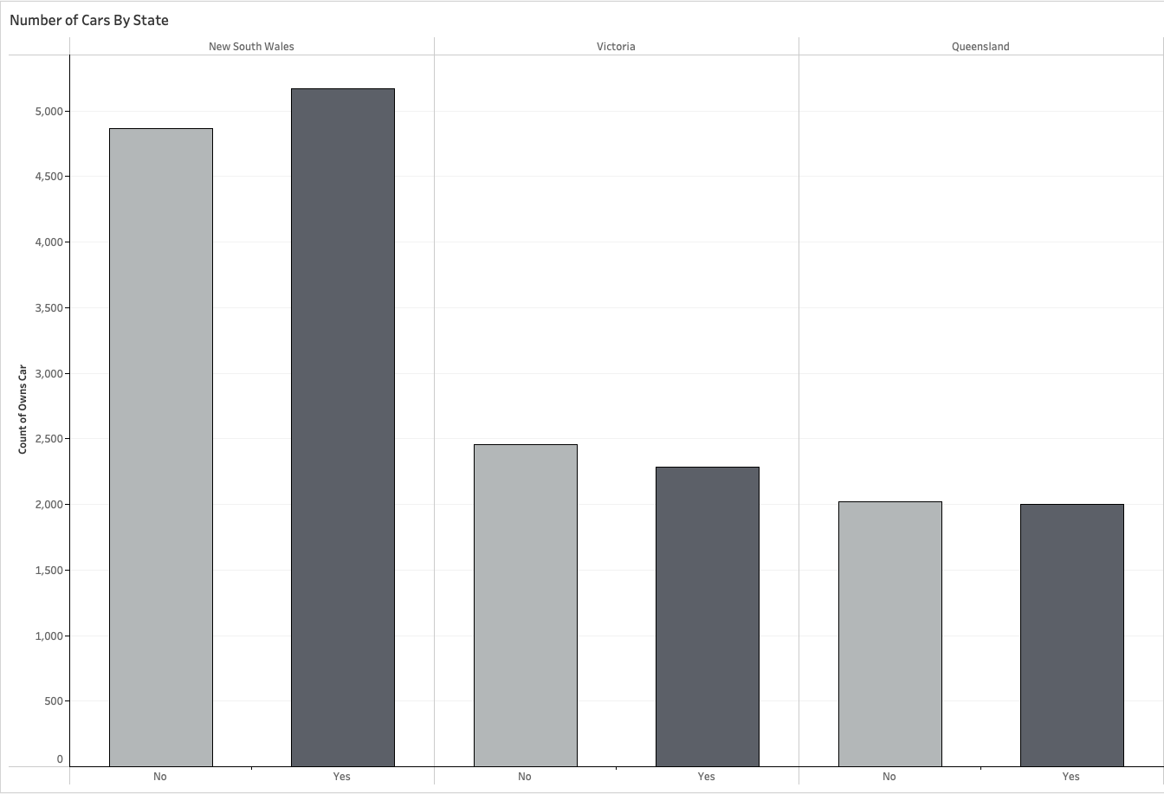
Number of Cars Owned in each State
New South Wales has the most potential since there is a chance to locate valuable clients there because the number of car owners there is almost equal to the number of non-owners.

Slide 8
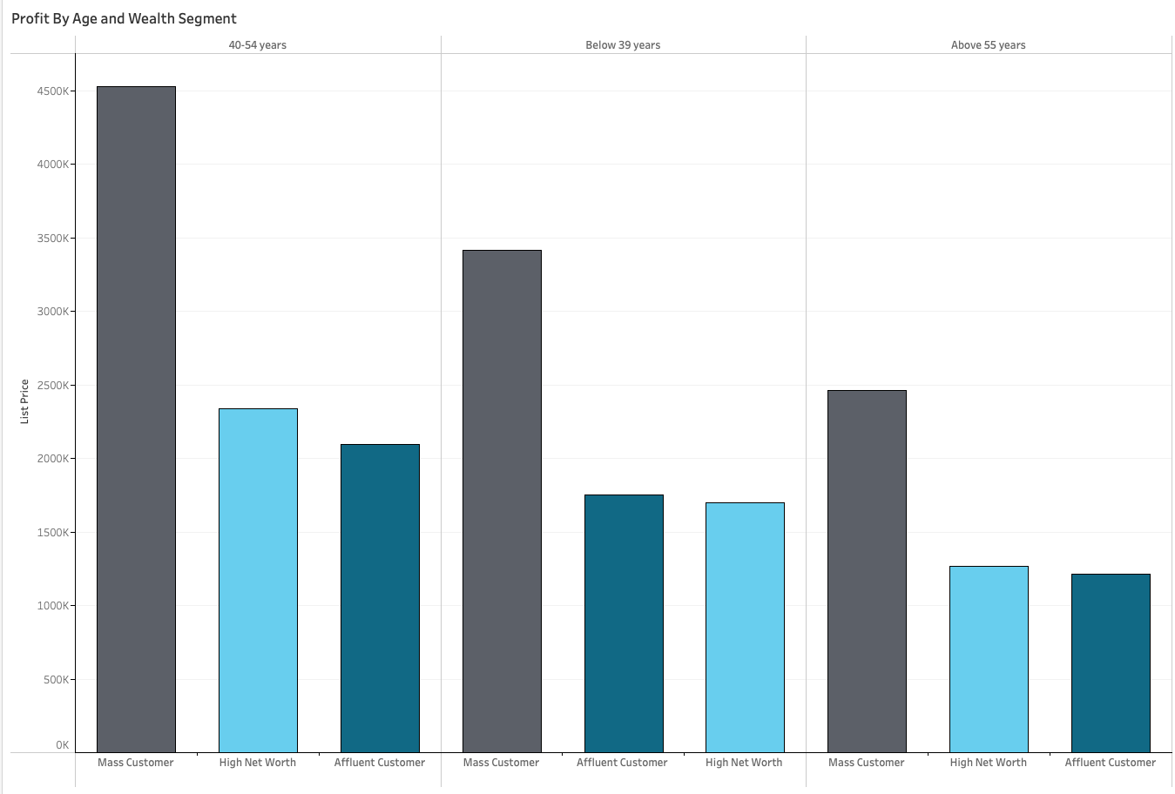
Profit of Wealth Segment By Age Bracket
Overall, across all age groups, the mass customer segmentation generates the most profit.
Compared to others, mass consumers between the ages of 40 and 45 are likely to bring in more money.

Slide 9
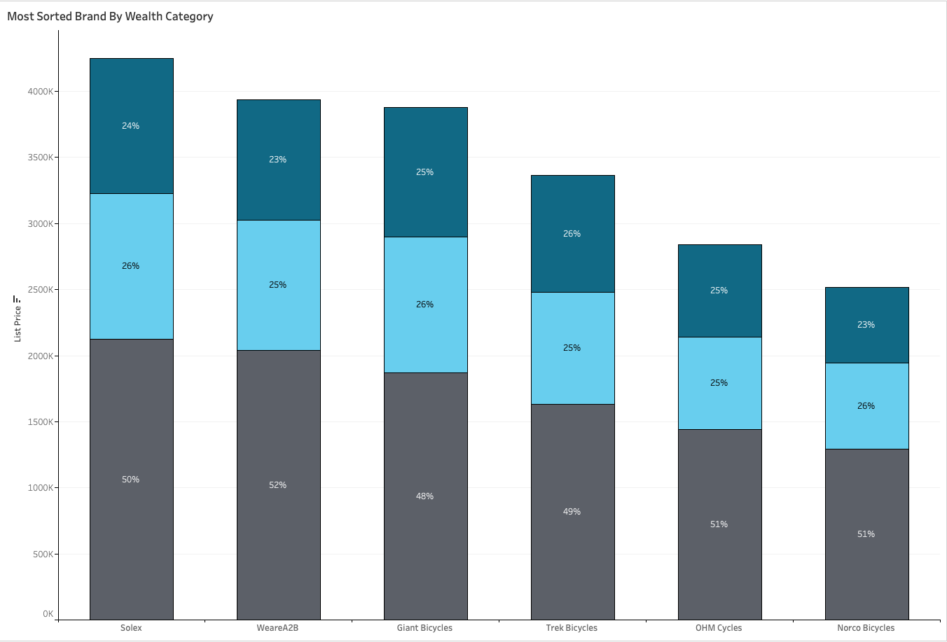
Most Popular Brand By Category of Wealth
Overall, Solex generated the greatest sales out of all the brands. Therefore, appears to be the most popular brands of all followed by WeareA2B.
Only that based on profit generated, WeareA2B generated more profit for the company.
By wealth segmentation as well as across all brands, mass consumers made the most profit.

Slide 10
Model Development
RFM Analysis and Customer Classification.
These are the high valued customers that should be targeted from the new list;
The majority of the high-value clients will be the Mass Customers.
Who are women in comparison to men.
Aged between 40 and 54 years and below 39 years.
Employed in the Manufacturing, Financial, or Health industries
Who purchases from WeareA2B and Solex Brands more frequently and
They presently reside in New South Gates and Victoria.

Slide 11
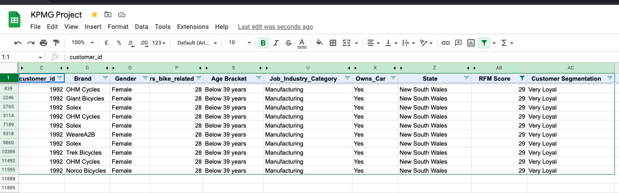
Interpretation
Summary table of the Most Valuable Clients
Here is a list of a few customers who fall under the category of high value customers.
Additionally, customers who are male, under 39 years old, and work in the Financial services sector made greater purchases of Bike related products
Fore more insights you can interact with the dashboard here Sprocket Central Dashboard

Slide 12
THANK YOU

